Slide 1
Teeth Wreath™
Peyton, Peyton, and Grace
Hour 1

Slide 2
The Teeth Wreath™
The Teeth Wreath™ is a one of a kind device to help people with dentures live their normal life. The Teeth Wreath™ gives people the dentures they need, while still allowing them to be athletic. The Teeth Wreath™ is a special device that holds your dentures in place with a small string that is almost invisible!

Slide 3

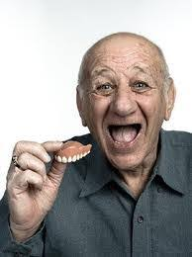
Target Market
Our target market ranges from 41 to 55 years old. We are targeting the upper end of that spectrum. People of this age are usually financially stable, close to retirement, still physically active, and most importantly… on the verge of being toothless.

Slide 4


Product
The Teeth Wreath™ :
Variety of different sizes, colors, and materials to choose from
Features Includes a cleaning kit, premium materials made in the USA, and our wreath has a copper infused extremely durable cord to keep your dentures from hitting the disgusting floor.
Includes 3 year warranty and the Teeth Wreath™ has been certified by the American Dental Association

Slide 5

Price
Dentures:
Retail/Consumer Price- $599.99
Wholesale/Industrial Price-$399.99
Wreath:
Retail/Consumer- $19.99
Infomercial- $9.99 + Shipping/Handling
Special Deal- Buy 4 get 1 free
Wholesale/Industrial- $9.99
Cleaning Kit:
Retail/Consumer- $29.99
Special Deal- 1 free kit with purchase of Dentures
Wholesale/Industrial- $19.99

Slide 6



Place
One of the locations you may find our product is in large retail stores such as Walmart and Target. You can purchase our accessories such as the wreath and cleaning kit. This is a very accessible location to get accessories for our product in a pinch!
The best place to find our product is by calling the number provided in our infomercials, (811) 111-1111. This is where you will find the best pricing and deals on all of our products!
The second location is through licensed dental providers in your city. You will be able to pay for the dentures and get fit for a pair all in one location. That is pretty convenient!

Slide 7
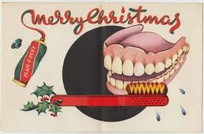
Promotion
Famous older athletes endorsements
If Gen X sees other people buying and using this product, they are more likely to buy it
Commercials on news networks (CNN, Fox News, ABC)
People in this generation usually watch news
Plan promotional campaigns around Christmas
The original Teeth Wreath is red and green
It has “wreath” in the name- remind of Christmas

